Slide 1

Session Topic: Writing Effective Learning Objectives-using Bloom’s Taxonomy
TAE Trainer: Marie Gerantonis

Slide 2


Acknowledgement of Country
I would like to take the time to pay respect to,
and acknowledge, the Wurundjeri people of
the Kulin Nation as the Traditional Owners of
the land we are on today. I extend that
respect to Elders, past and present, to
leaders emerging, and to all Indigenous
people here today.

Slide 3
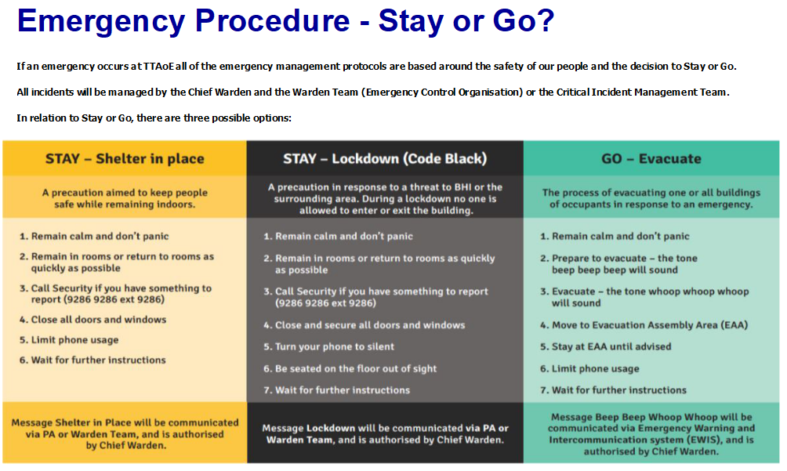

Slide 4
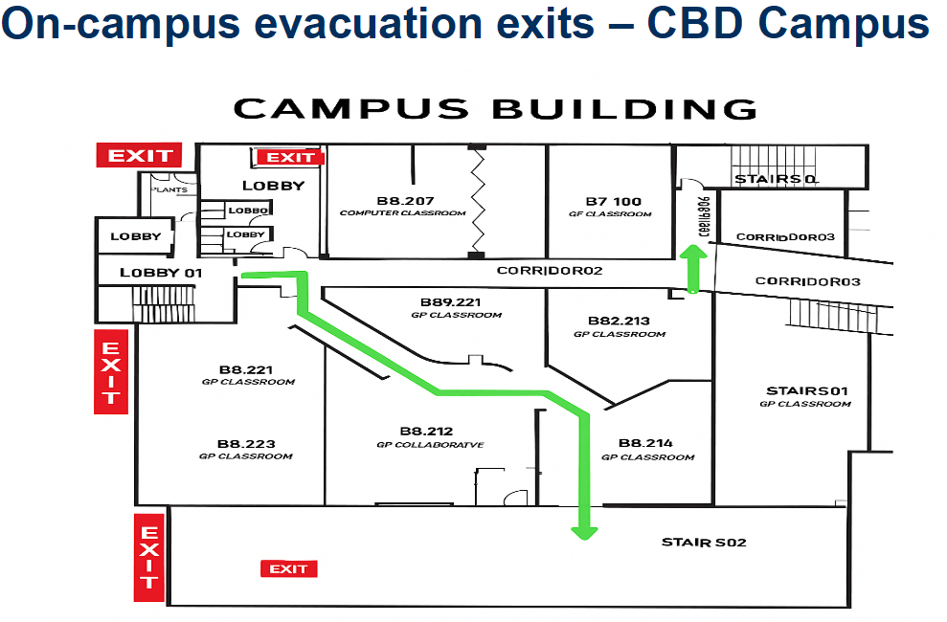

Slide 5
Evaluate the following learning Objectives using SMART
By the end of this session participants should be able to:
Know everything about Bloom’s Taxonomy.
Understand how to use Bloom’s Taxonomy properly.

Slide 6
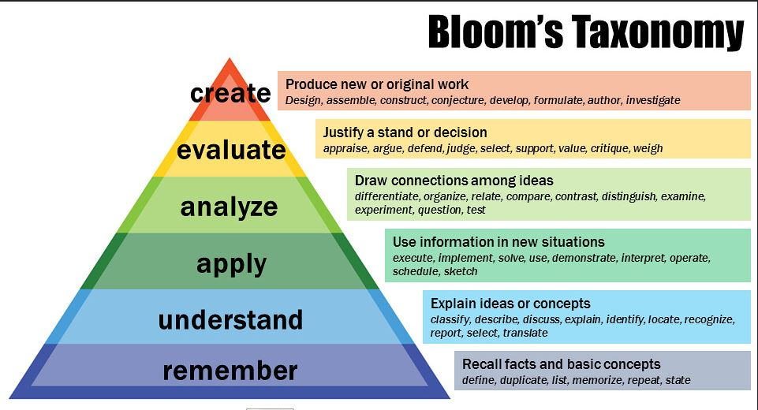

Slide 7

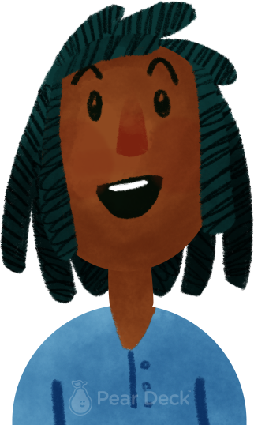
What is a good Objective? Why?
Be SMART (Specific, Measurable, Achievable, Realistic, Time-Appropriate)
Notes:
Thinking Broadly
Identifying and articulating questions we have is an important thinking skill. Give students the opportunity to think broadly about today’s topic and identify their own questions. Show their responses anonymously on the projector to discuss.
🍐 This is a Pear Deck Text Slide
🍐 To edit the type of question, go back to the "Ask Students a Question" in the Pear Deck sidebar.

Slide 8

Can you identify the weaknesses? Draw or type anywhere:
At the end of this course (undergraduate, one semester), students should be able to perform open-heart surgery successfully.
Notes:
Mind Map
Starting with a central idea, give students time to branch out their thoughts visually to help build connections.
🍐 This is a Pear Deck Drawing Slide
🍐 To edit the type of question, go back to the "Ask Students a Question" in the Pear Deck sidebar.

Slide 9

For this activity you will evaluate the following Objective:
By the end of this session, (undergraduate) students should know how to use AI properly.
Make the Learning Objective Clear
Work individually but if you finish early you can always offer to help your peers.
Step One
What makes this objective unclear?
Which parts make it hard to measure of assess?
(Note down issues such as: Vague verb, ambiguous terms, not measurable, not clear context)
Step Two
Rewrite the Objective to make it clear. Think about the following:
What do students actually do to demonstrate learning
What kind of AI use should be addressed eg writing, research, ethical decision making?
Step Three
Present your revised learning Objectives. Discussion:
Which Cognitive level each objective targets?
How precise wording improves the ability to assess Learning objectives?
Notes:
🍐 This is a Pear Deck Text Slide
Instructions Template
Use this template to display instructions for your activity. Everyone works at a different pace. Help students who finish early know appropriate ways to use their time. For example, maybe you want them to help their peers, discuss with a peer, move on to a more advanced activity, or do some quiet reading.

Slide 10
Examples of improved Objectives
By the end of this session, students will be able to: identify examples of appropriate and inappropriate uses of AI in academic writing.
By the end of this session, students will be able to: apply institutional guidelines to evaluate whether an AI-generated text meets academic integrity standards.
By the end of this session, students will be able to: explain how to acknowledge AI assistance in written assignments according to referencing conventions.

Slide 11
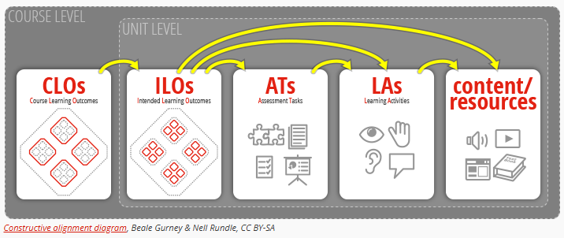
Constructive alignment
The principle that learning objectives, teaching activities, and assessment tasks should all align.

Slide 12
Learning Objectives of this session
By the end of this session the participants should be able to:
Evaluate learning Objectives
Write a well-defined learning objective using Bloom’s Taxonomy
When writing Learning Objectives we need to think of what we want the learners to achieve
Start with an action verb (eg create, evaluate, analyse, apply, explain) and BE SMART

Slide 13

In one minute, write the most important thing from today’s session.
Thank you!
Notes:
Takeaway
Use this template to help students articulate and retain their biggest takeaways from the day.
🍐 This is a Pear Deck Text Slide
🍐 To edit the type of question, go back to the "Ask Students a Question" in the Pear Deck sidebar.

